Slide 1

B2C Product Launch strategy for
FOXTALE – Skincare Brand
The outline of the project is to design a product launch strategy for a skincare product through social commerce on Instagram and Facebook. Leveraging their product through Instagram Shopping, Facebook Ads and Influencer Collaborations and by tracking their Sales, Conversions and Customer feedback.

Slide 2
MARKET RESEARCH REPORT : FOXTALE
OVERVIEW:
BRAND NAME: Foxtale
FOUNDED: 2021
HEADQUARTERS: Mumbai, India
PRODUCT RANGE: Skincare products (cleansers, moisturizers, serums, etc.)
POSITIONING: Science-backed, minimalist skincare solutions for modern consumers.
MARKET POSITIONING
UNIQUE SELLING PROPOSITION (USP):
Focus on simple, effective, and dermatologist recommended formulations.
Emphasis on storytelling and relatable branding to connect with younger audiences.
Subscription-based model for customer retention.
PRICE RANGE:
Mid-to-premium pricing (Price ranging from ₹500 to ₹1,500)
DISTRIBUTION CHANNELS:
Primarily online (Own website: https://foxtale.in/ and Nykaa, Amazon, etc.)

Slide 3


FOXTALE’S STRENGTH AND WEAKNESS
1.Science-backed, dermatologist-recommended products.
2.Minimalist and effective formulations
1.Limited product range compared to competitors.
2.Premium pricing may deter budget-conscious consumers.
3.Strong digital marketing and storytelling.
4.Subscription model for customer retention.
3.Relatively new brand with lower awareness compared to established players.

Slide 4

Social Media Audit – Feb2025
Primary Social Media Channel : Instagram
Username: @foxtaleskin
Total No.of.Followers: 251.6K
With an Engagement rate of 0.23%.
Total No.of.Post: 1.7k
Monthly income – Feb2025 - $2.8K – 3.9K
Yearly earnings - $33.8K – 46.3K
On average, each post receives around
554 likes and 42 comments.
Link: https://www.instagram.com/foxtale_india/

Slide 5
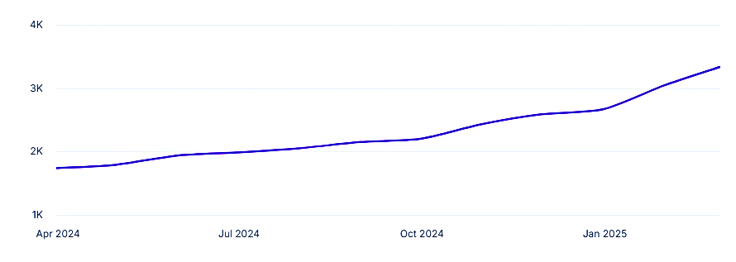
From March 2024 to February 2025, Instagram: @foxtaleskin’s
income estimates ranged from $1,743 to $3,341.
Instagram: @foxtaleskin’s earnings are currently on an upward trend.
This graph depicts changes in an influencer’s income over time.
Each point plotted on the graph represents the average value of that month’s income

Slide 6
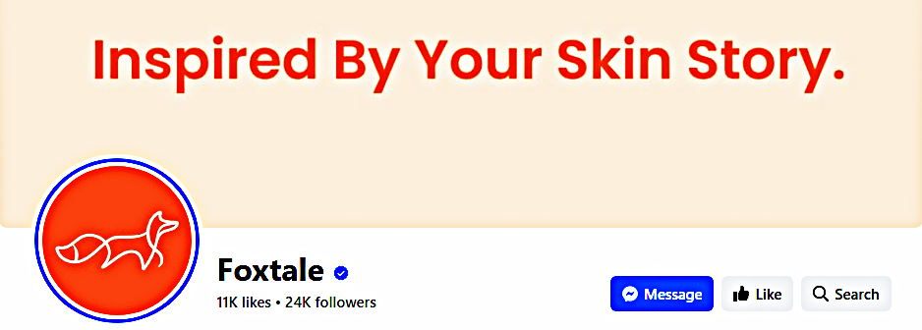
FACEBOOK PAGE
Foxtale shares updates about new product launches, skincare tips,
blog articles, and promotional events.
They also interact with their community through comments and messages.
Total no.of.followers:24k
24k followers might expect approximately 773 engagements per post.
Link: https://www.facebook.com/foxtaleindia
OTHER SOCIAL MEDIA PRESENCE:
TWITTER
Foxtale's Twitter profile is used to share quick updates, engage in
skincare-related conversations, announce promotions
and respond to customer inquiries.
Link: https://twitter.com/foxtale_india

Slide 7
LinkedIn
Foxtale shares company news, industry insights, collaborations
and career opportunities, targeting professionals in the skincare and
beauty industry.
Company Profile Link: https://www.linkedin.com/company/foxtale-india
YOUTUBE
Foxtale's YouTube channel offers in-depth content such as skincare
tutorials, product reviews,
interviews with skincare experts,
and informational videos about ingredients and routines.
Link: https://www.youtube.com/channel/UCx0QXZQpDPkoWnamc1G6ibA
YouTube Channel: @FoxtaleSkin
Content: Celebrating skincare that "Works Wonders" and people who use it.
Subscribers: 9.01K
Videos: 108

Slide 8
COMPETITOR ANALYSIS
DIRECT COMPETITOR :
Dot&Key – Skincare Product Brand
Affordable, trendy, and wide product range.
INDIRECT COMPETITORS:
The Ordinary:
Known for minimalist, ingredient-focused skincare.
Cetaphil:
Dermatologist-recommended, trusted by sensitive skin users.
COMPETITIVE ADVANTAGE:
Foxtale’s focus on storytelling, subscription model
and dermatologist-backed formulations sets it apart.

Slide 9
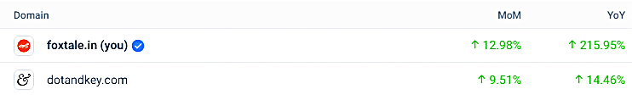
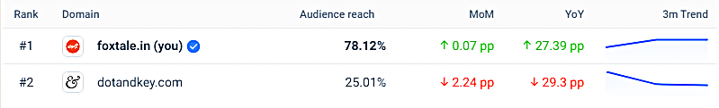
ANALYSIS OF BENCHMARK REPORT :
This report gives the performance of the Foxtale brand when compared to the competitor’s
brand Dot&Key.
Compared to Dot&Key the website
Visit of the Foxtale was increased by
3.47%
Compared to Jan2025 the Monthly visit
of Foxtale is increased by 4k in Feb2025.
Compared to Dot&Key the audience
reach of Foxtale is increased by 50%
Direct Traffic source of Foxtale for
Feb2025 (last month) is 56.68%
Traffic source of Foxtale from SOCIAL MEDIA for Feb2025 (last month) is 4.41%

Slide 10
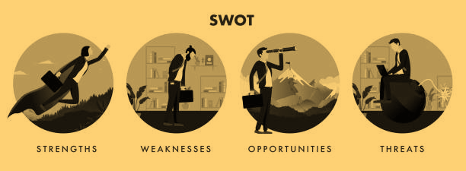
SWOT analysis of a competitor: DOT&KEY
STRENGTH | WEAKNESS | OPPORTUNITIES | THREATS
Budget-friendly pricing and Collaborations with influencers and celebrities boost brand visibility. | Some products may not suit all skin types, leading to inconsistent customer satisfaction. | Potential to enter global markets with its affordable and trendy offerings. | Risk of counterfeit products affecting brand reputation.
Focuses on popular ingredients like Hyaluronic acid, vitamin C, and AHAs/BHAs. | Faces intense competition from both established and emerging skincare brands. | Introduce new categories like hair care and Develop eco-friendly packaging to attract conscious consumers. | Need to constantly innovate to keep up with evolving consumer preferences.

Slide 11
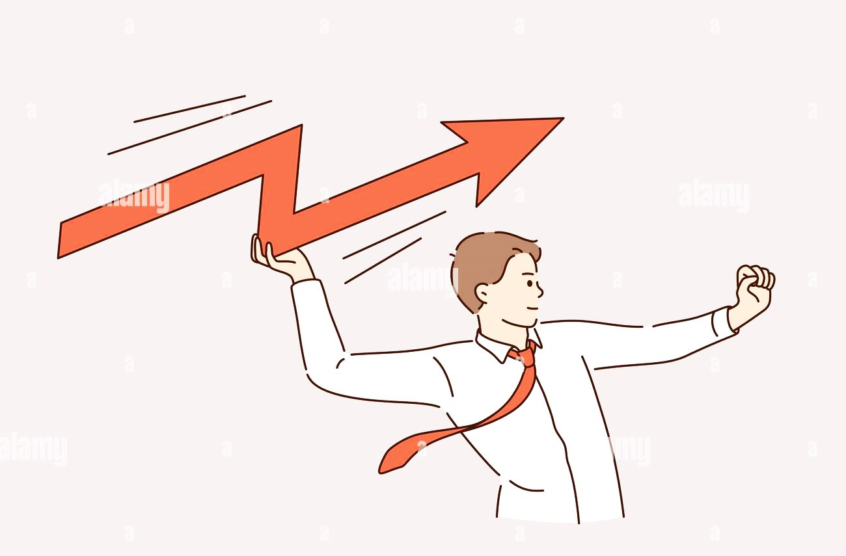
AREAS FOR IMPROVEMENT IN FOXTALE WHEN COMPARED TO DOT&KEY
Expand product range to compete with broader portfolios of Dot & Key.
Enhance offline presence to reach a wider audience.

Slide 12
OPPORTUNITIES TO IMPROVE
FOXTALE SKINCARE BRAND IN MARKET
Product Expansion:
Introduce new categories like Haircare, Men’s grooming, or Body care.
Sustainability Initiatives:
Develop eco-friendly packaging and clean beauty products.
Global Expansion:
Enter international markets with its science-backed approach.
Collaborations:
Partner with dermatologists or celebrities to enhance credibility.

Slide 13

PRODUCT LAUNCH STRATEGY
FOR
SOCIAL MEDIA PLATFORM- FOXTALE
(Instagram & Facebook)
PRE-LAUNCH
WEEK1- BUILD ANTICIPATION OF A PRODUCT
Goal: Build anticipation and curiosity about the upcoming product.
LAUNCH
WEEK2- PRODUCT REVEAL & ENGAGEMENT
Goal: Officially launch the product and drive immediate sales.
POST-LAUNCH
WEEK3- ENGAGEMENT & SOCIAL PROOF
Goal: Build trust, showcasing the results from customers.
WEEK4- RETENTION
Goal: Retain customers and encourage repeat purchases.

Slide 14
OVERVIEW OF FACEBOOK AD CAMPAIGN
Phase 1: Awareness
Run a Brand Awareness or Video Views campaign to introduce the new product and highlight its benefits.
(EXAMPLE: "Introducing our new oil free moisturizer!").
Phase 2: Consideration
Use a Traffic or Engagement campaign to drive users to your website or get them interacting with your content.
(e.g., "Learn how our new moisturizer transforms your skin").

Slide 15
Phase 3: Conversion
Launch a Conversions or Catalog Sales campaign to drive purchases, retargeting users who showed interest earlier.
(EXAMPLE: "Don’t miss out—shop now!").
Phase 4: Retention
Use a Retargeting Campaign to re-engage users who didn’t convert or offer loyalty discounts to repeat customers.

Slide 16
IDEAS FOR SUCCESSFUL PRODUCT LAUNCH
1.Highlight the unique selling points (USPs) of our skincare product.
(EXAMPLE: "Dermatologist-tested," "Vegan," "Cruelty-free").
2.Use before-and-after visuals or testimonials to build trust.
3.Offer limited-time discounts or bundles to create urgency.
4.Test different ad creatives ( EXAMPLE: Videos, Carousels, Single images) to see what resonates best with your audience.

Slide 17
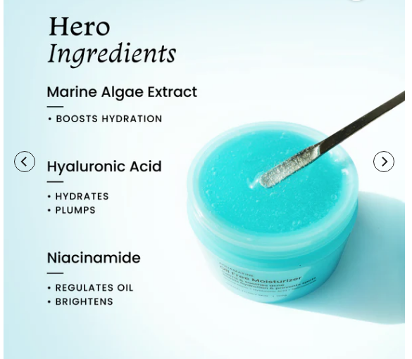
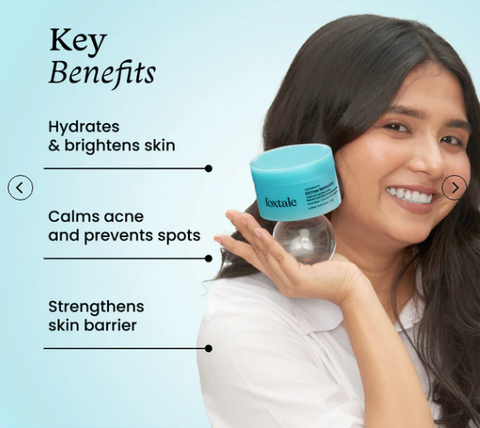
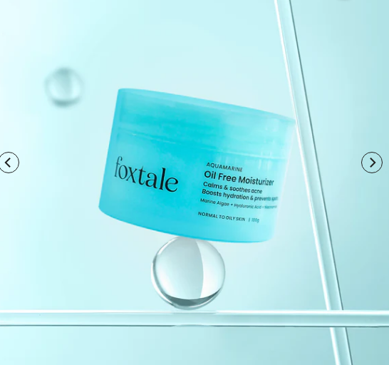
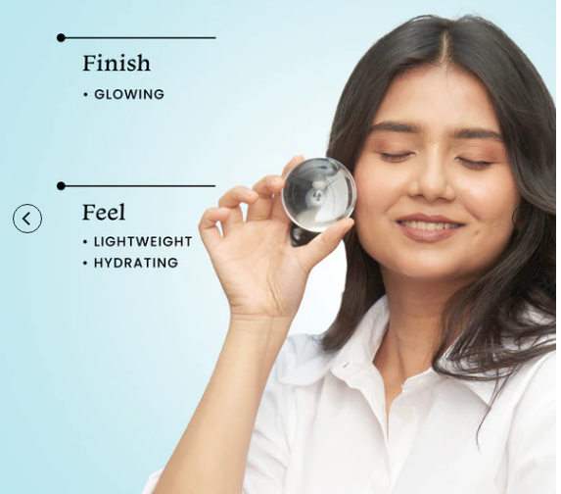
PRODUCT IMAGES
OIL FREE
MOISTURIZER

Slide 18
CAMPAIGN OBJECTIVES FOR A SKINCARE
PRODUCT LAUNCH
1. Brand Awareness
Goal: Introduce the new skincare product to a broad audience and reinforce brand recognition.
Pre-Launching Time: At the start of the launch to create buzz and let people know about the new product.
Targeting: Broad audience targeting based on demographics, interests (EXAMPLE: Skincare, Beauty, Wellness), and behaviors.
Ad Formats: Video ads or carousel ads showcasing the product's benefits and features

Slide 19
2. Traffic
Goal: Drive traffic to your product page or landing page to educate users about the new product.
Launching Time: After creating initial awareness to direct users to learn more about the product.
Targeting: Target users interested in skincare, beauty, or similar products.
Ad Formats: Click-to-website ads with a strong CTA like "Shop Now" or "Learn More."

Slide 20
3. Engagement
Goal: Increase interactions (likes, comments, shares) with your product-related content.
After the Launching Time: To build excitement and create a conversation around the new product.
Targeting: Target your existing followers or users interested in skincare and beauty.
Ad Formats: Polls, questions, or interactive video ads. (EXAPMLE: "What’s your biggest skincare concern?").

Slide 21
4. Conversions
Goal: Drive purchases or specific actions. (EXAMPLE: Add to cart, Sign up for a trial).
During Launch Time: When you want to push for sales directly.
Targeting: Retarget users who have interacted with your brand or target lookalike audiences.
Ad Formats: Dynamic product ads, carousel ads, or single image/video ads with a strong CTA like "Buy Now" or "Get Yours Today."

Slide 22
5. Retargeting Campaign
Goal: Re-engage users who have interacted with your brand but didn’t convert.
Post-Launching Time: After running awareness or traffic campaigns to bring users back.
Targeting: Target users who visited your website, added to cart, or engaged with your content.
Ad Formats: Special offer ads.
(EXAMPLE: "Get 10% off your first purchase") or dynamic product ads.

Slide 23
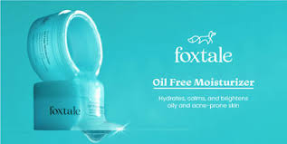
IDEAS FOR CREATING ENGAGING VIDEO CONTENT FOR SKINCARE PRODUCT ON
FACEBOOK & INSTAGRAM
WITH
CREATIVITY, STORYTELLING AND
STRAGTEGIC TARGETING.
Here am choosing the skincare product from the Foxtale-skincare brand
and the product name is “OIL FREE MOISTURIZER”.

Slide 24
1. Highlight the Product’s Unique Selling Points (USPs)
STRATEGY:
Focus on what makes your skincare product stand out. VIDEO IDEAS:
BEFORE & AFTER TRANSFORMATION:
Show real or simulated results of using the product.
INGREDIENT SPOTLIGHT:
Highlight key ingredients and their benefits. Example: Hyaluronic acid, vitamin C etc
HOW IT WORKS:
Demonstrate the product in action.
Example: Applying a product on the face.
Ad Copy Example – FOXTALE – OIL FREE MOISTURIZER "Transform your skin with oil free moisturizer”! 1.Reduces fine lines 2.Brightens dull skin 3.Hydrates for 24 hours Ready to glow? Tap to shop now! #GlowUp #SkincareEssentials#foxtale#foxtaleskincare

Slide 25
2.LeverageUserGeneratedContent(UGC)
STRATEGY:
Showcase real customers using and loving your product. VIDEO IDEAS:
CUSTOMER TESTIMONIALS: Share short video clips of customers raving about the product.
UNBOXING VIDEOS: Feature customers unboxing and trying the product for the first time.
CHALLENGE OR TREND:
Create a branded hashtag challenge (Example: #GlowWith Foxtale) and encourage users to share their results.
Ad Copy Example- FOXTALE – OIL FREE MOISTURIZER "Don’t just take our word for it—here’s what our customers are saying! ‘[Customer Quote- Are Foxtale product worth it]’ – [Customer Name-Riya] Ready to try it for yourself? Tap the link to shop now! #CustomerLove#Glowwithfoxtale#Reviews#moisture#worthformoney#foxtaleskin#skincare

Slide 26
3. Educate Your Audience
STRATEGY:
Position your brand as an authority by sharing skincare tips and tutorials. VIDEO IDEAS:
SKINCARE ROUTINE: Show how to incorporate the product into a daily skincare routine.
SEASONAL TIPS: Share skincare tips for different seasons. Example:“Summer Skincare Must-Haves“.
Ad Copy Example – FOXTALE – OIL FREE MOISTURIZER "Did you know? What to apply after moisturizing cream?
Skincare Tip for summer – switch to lightweight moisturizers Upgrade your routine with oil free moisturizer from Foxtale and see the difference! Tap to learn more and shop now. #SkincareTips #GlowGoals"

Slide 27
4. Create Emotional Connections
STRATEGY: Use storytelling to connect with your audience on a deeper level. VIDEO IDEAS:
JOURNEY TO GLOW: Share a story of someone overcoming skin issues with your product.
SELF-CARE FOCUS: Highlight the importance of self-care and how your product fits into that.
BEHIND-THE-BRAND: Show the story of your brand, its mission, and why you created the product.
Ad Copy Example – FOXTALE – OIL FREE MOISTURIZER "Your skin tells your story—let it shine! With OIL FREE MOISTURIZER, you’re not just buying skincare,
you’re investing in self-love. Tap to shop now and start your glow-up journey. #SelfCare #GlowWithUs"

Slide 28
5. Use Humour and Relatability
STRATEGY: Make your audience laugh or nod in agreement to build a connection. VIDEO IDEAS:
RELATABLE SKINCARE STRUGGLES: Create funny skits about common skincare problems.
Example: "When you forget to moisturize your skin”.
PRODUCT PARODY: Playfully exaggerate the benefits of your product in a humorous way.
MEME CULTURE: Use trending memes to promote your product in a lighthearted way.
Ad Copy Example –FOXTALE – OIL FREE MOISTURIZER “Sensitive skin? Dry skin? Reddishness ? Breakouts? We’ve all been there. Say goodbye to skincare struggles with FOXTALE’S OIL FREE MOISTURIZER! Tap to shop now and laugh your way to glowing skin. #SkincareHumor #GlowUp"

Slide 29
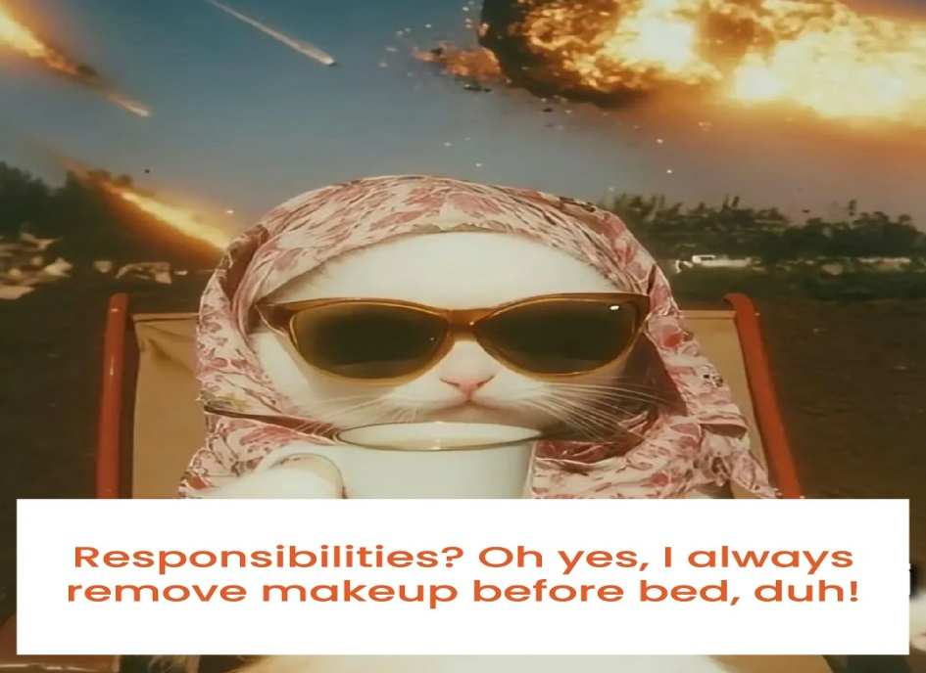
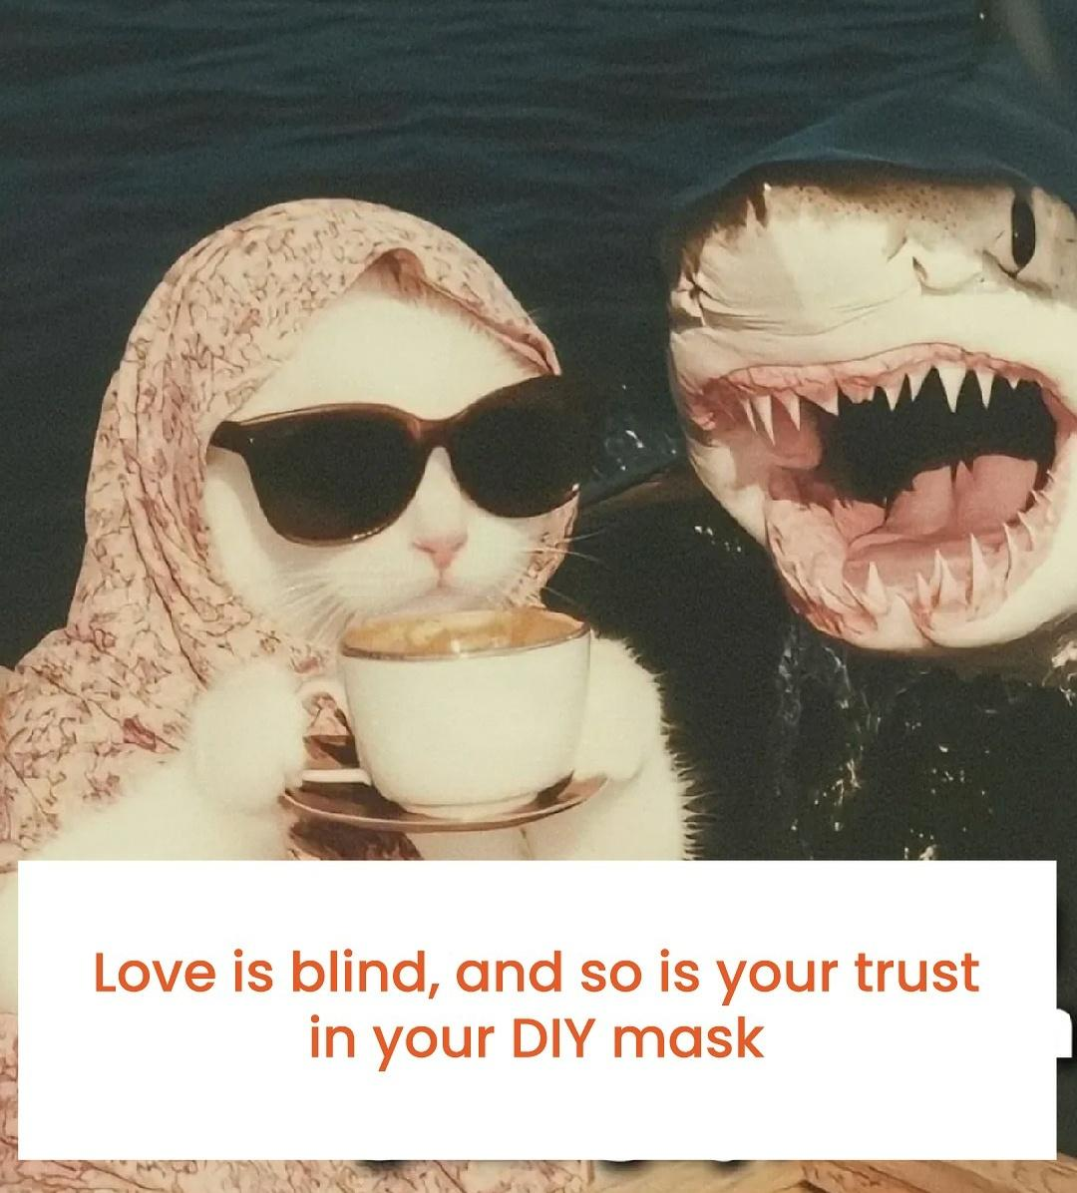
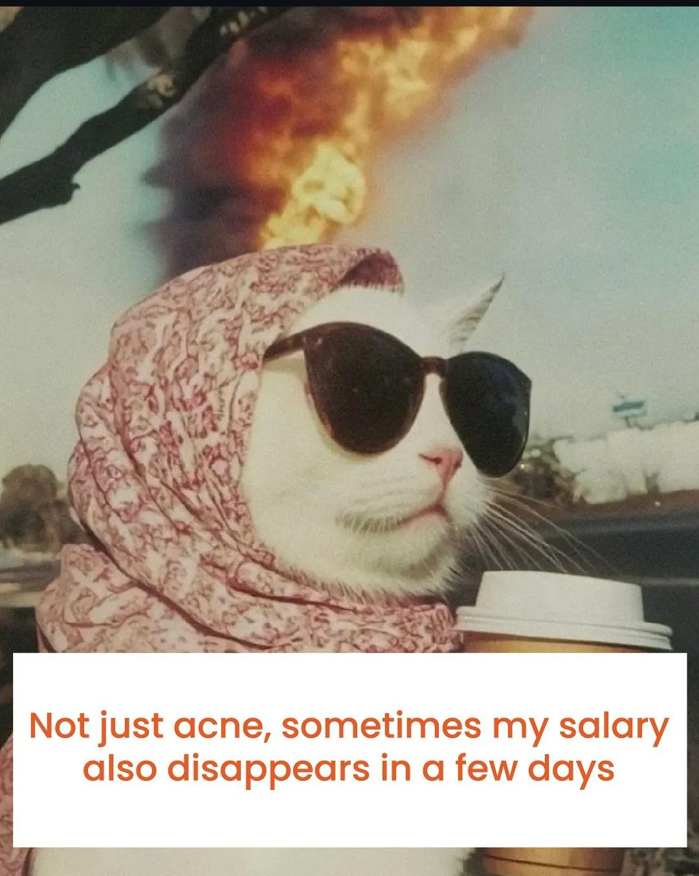
IMAGES OF SOME HUMOUR POST IN FOXTALE

Slide 30
6. Offer Limited-Time Promotions
STRATEGY:
Create urgency with exclusive deals or flash sales. VIDEO IDEAS:
COUNTDOWN TIMER: Show a timer ticking down to the end of a sale.
FLASH SALE ANNOUNCEMENT:
Use bold text and visuals to announce a limited-time offer.
BUNDLE PROMO:
Highlight a discounted bundle of products.
Ad Copy Example – FOXTALE – OIL FREE MOISTURIZER "Flash Sale Alert! Get 10% OFF OIL FREE MOISTURIZER for the next 24 hours only! Don’t wait—shop now before it’s gone! Tap the link to grab your glow. 👇 #FlashSale #GlowDeals

Slide 31
7. Partner with Influencers
STRATEGY: Collaborate with influencers to reach their engaged audiences. VIDEO IDEAS:
INFLUENCER UNBOXING: Show an influencer unboxing and trying your product for the first time.
TUTORIAL: Have an influencer demonstrate how to use the product.
REVIEW: Feature an influencer sharing their honest opinion about the product.
Ad Copy Example – FOXTALE – OIL FREE MOISTURIZER "Here’s what Jennifer Winget (Celebrity of Hollywood) has to
say about OIL FREE MOISTURIZER! Ready to glow like JENNIFER WINGET in this summer? Tap to shop now! 👇 #InfluencerApproved #GlowUp"

Slide 32
8.Use Eye-Catching Visuals and Trends
STRATEGY:
Leverage trending formats, music, and visuals to grab attention. VIDEO IDEAS:
TRENDING REELS:
Use popular music and effects to create engaging Instagram Reels or Short videos for YouTube
STOP MOTION: Create a stop-motion video of the product in use.
ASMR: Use satisfying sounds (e.g., applying serum, tapping on skin) to captivate viewers.
GRWM: Before using the product and after using the product result on skin.
Ad Copy Example – FOXTALE – OIL FREE MOISTURIZER "Glow-up in motion!
Watch how OIL FREE MOISTURIZER transforms your skin in seconds. Tap to shop now and join the trend! #GRWM #GlowReels"

Slide 33
9. Retarget Interested Customers
STRATEGY:
Use retargeting ads to re-engage users who visited your website or interacted with your content. VIDEO IDEAS:
ABANDONED CART REMINDER: Show the product and remind users to complete their purchase.
PERSONALIZED RECOMMENDATIONS: Suggest complementary products based on their browsing history.
CUSTOMER TESTIMONIALS: Showcase reviews from other customers to build trust.
Ad Copy Example – FOXTALE – OIL FREE MOISTURIZER "Still thinking about it? Don’t miss out on OIL FREE MOISTURIZER —your glow awaits! Tap to complete your purchase now. #GlowUp #SkincareEssentials"

Slide 34
10. Highlight Sustainability and Ethics
STRATEGY:
Appeal to eco-conscious consumers by showcasing your brand’s values. VIDEO IDEAS:
ECO-FRIENDLY PACKAGING:
Show how your product packaging is sustainable.
ETHICAL SOURCING:
Highlight how your ingredients are sourced responsibly.
CHARITY PARTNERSHIPS: Share how a portion of sales supports a cause.
Ad Copy Example – FOXTALE – OIL FREE MOISTURIZER "Glow Oil free responsibly in summer! With OIL FREE MOISTURIZER, you’re not just caring for your skin—you’re caring for the planet. Tap to shop now and join the movement. #EcoFriendly #SustainableSkincare"

Slide 35
IDEAS FOR LAUNCHING A SKINCARE PRODUCT THROUGH SOCIAL COMMERCE
WITH
INFLUENCER MARKETING
STRATEGIES FOR INFLUENCER MARKETING
INDENTIFY THE RIGHT INFLUENCER FOR A SKINCARE BRAND
Micro-influencers (10K–100K followers) :
1.Micro-influencers often have highly engaged audiences and niche communities. They are seen as more authentic and relatable, which can lead to higher trust and conversion rates.
2.Skincare experts to build credibility and drive conversions.

Slide 36
MACRO-INFLUENCERS ( 500K - IM FOLLOWERS)
Gradually scale up to Macro-influencers has to focusing on specific niche or industry such as beauty influencers or celebrities for broader campaigns.
NANO-INFLUENCERS (1K - 10K FOLLOWERS)
Incorporate UGC creators like collaborating with everyday users or nano-influencers can create authentic because User-generated content (UGC) that resonates with real customers to maintain authenticity and build a community around Foxtale.

Slide 37

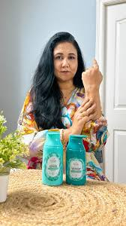
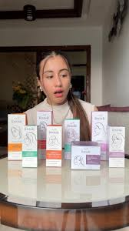
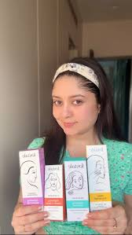
SOME EXISTING EXAMPLES OF INFLUENCER COLLABORATION FOR FOXTALE’S SKINCARE PRODUCT
THESE ARE SOME MICRO,MACRO AND NANO INFLUENCER WHICH THEY COLLAB WITH FOXTALE SKINCARE PRODUCTS COLLABRATION IN INSTAGRAM
48k- views
2.2k-likes
70-comments
5.35k-views
63-likes
22-comments
4.5k-views
100-likes
2-comments

Slide 38
KEY CONSIDERATIONS
AUDIENCE ALIGNMENT:
Ensure the influencer’s audience matches Foxtale’s target demographic (age, gender, location, interests).
CONTENT STYLE:
Choose influencers whose content style aligns with Foxtale’s brand image (e.g., minimalistic, scientific, luxurious, or relatable).
ENGAGEMENT RATE:
Look for influencers with high engagement rates (likes, comments, shares) rather than just a large follower count.
BUDGET:
Micro-influencers are cost-effective and often yield better ROI, while macro-influencers and celebrities require a higher budget.

Slide 39
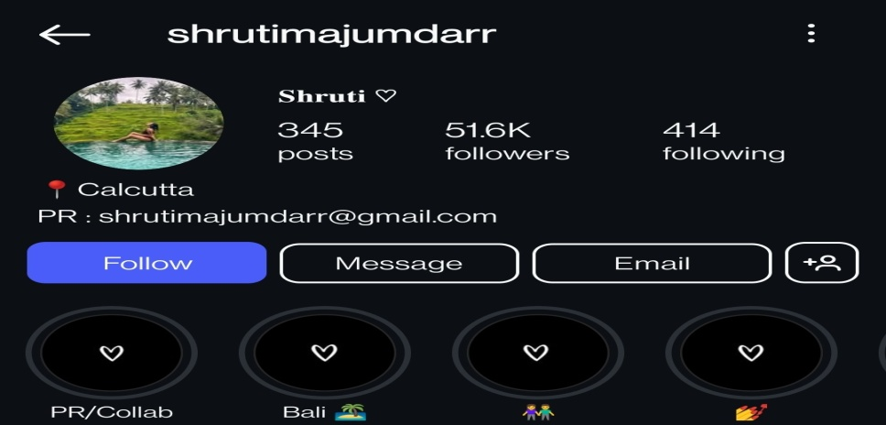
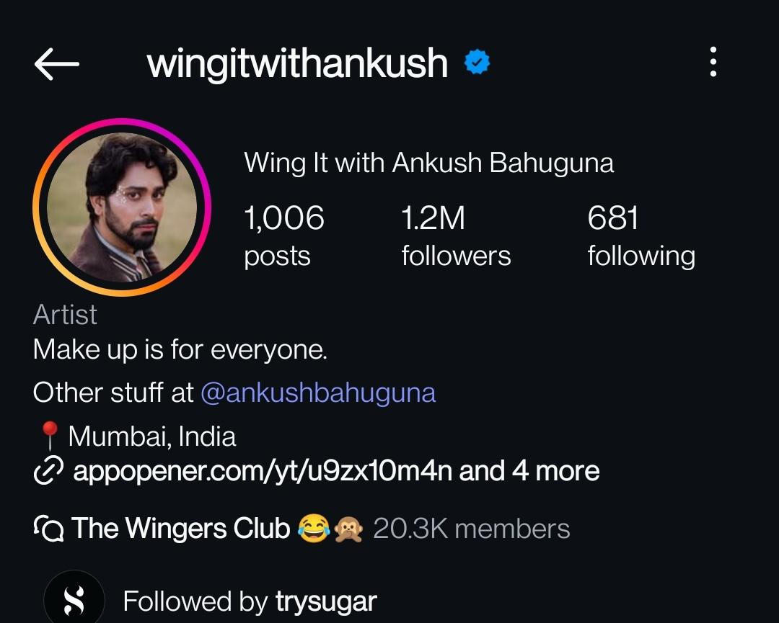
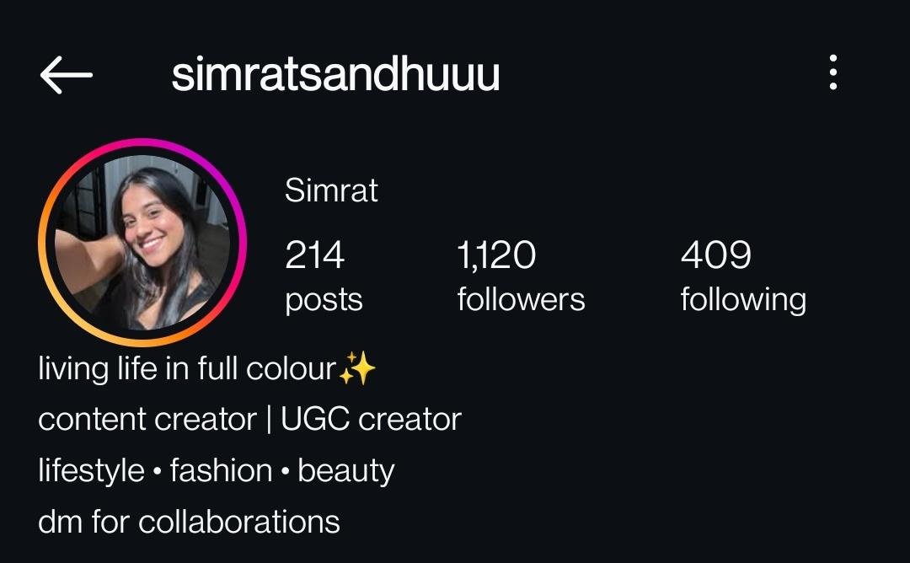
IMAGES OF SOME INFLUENCER COLLABORATION IN FOXTALE
MICRO-INFLUENCER – INFLUENCER HAS THEIR OWN COMMUNITY
MACRO-INFLUENCER – ALSO CALLED MEGA INFLUENCER AND THEY FOCUS ON SPECIFIC NICHE.
NANO- INFLUENCER- THEY ARE SMALLER IN NUMBER
BUT CAN BE HIGHLY ENGAGED AS THEY ARE
HYPER-TARGETED.

Slide 40
INFLUENCER COLLABORATION STRATEGIES FOR FOXTALE PRODUCT LAUNCH
1. Pre-Launch Phase (Build Hype)
Goal: Create buzz and anticipation for the product launch.
Influencer Teaser Campaign
Action: Partner with micro and macro influencers to tease the upcoming product.
Content Ideas:
Mystery Posts: Influencers post cryptic messages like "Something amazing is coming soon!" with a blurred product image.
Countdown Stories: Influencers share countdown stickers on Instagram Stories.
Behind-the-Scenes (BTS): Show influencers unboxing or testing the product before the launch.
EXAMPLE :
Sneak Peek Videos
Action Create short, engaging videos showcasing the product’s benefits.
Platform: Instagram Reels and YouTube Shorts.

Slide 41
2. Launch Phase (Drive Sales)
Goal: Officially launch the product and drive immediate sales through influencer collaborations and social commerce.
Influencer Unboxing & Tutorials
Action: Send influencers the product and have them create unboxing, tutorial, or review videos.
Content Ideas:
Unboxing: Show the product packaging and first impressions.
Tutorials: Demonstrate how to use the product in a skincare routine.
Before & After: Share results after using the product for a few days.

Slide 42
INSTAGRAM SHOPPING & FACEBOOK SHOPS
Action: Enable Instagram Shopping and Facebook Shops to make the product easily purchasable.
Content Ideas:
Shoppable Posts: Tag the product in influencer posts and stories.
Live Shopping: Host live shopping events with influencers demonstrating the product.
EXCLUSIVE INFLUENCER DISCOUNT CODES
Action: Provide influencers with unique discount codes to share with their followers.
Caption Example for Foxtale’s oil free moisturizer : "Get 10% OFF for oil free moisturizer with my code [CODE]! Tap the link in bio to shop now—your skin will thank you! #GlowDeals #InfluencerDiscount #SkincareLove#Foxtaleskins

Slide 43
3. POST-LAUNCH PHASE (ENGAGE & RETAIN)
Goal: Build trust, encourage repeat purchases, and retain customers.
User-Generated Content (UGC) Campaign
Action: Encourage customers to share their results using a branded hashtag. Example: #GlowWith Foxtale
Content Ideas:
Repost UGC: Share customer photos and videos on your brand’s social media.
Contests: Run a contest where customers can win prizes by posting their results.

Slide 44
INFLUENCER FOLLOW-UP REVIEWS
Action: Have influencers share follow-up reviews after using the product for a few weeks.
Caption Example for Foxtale’s oil free moisturizer : "It’s been 3 weeks, and I’m still loving product from Foxtaleskin! Here’s how it’s transformed my skin—tap the link in bio to shop now. #InfluencerReview #GlowResults #SkincareEssentials#foxtaleskin
RETARGETING ADS
Action: Use Facebook and Instagram ads to retarget users who interacted with your content or visited your shop.
Content Ideas:
Abandoned Cart Reminders: Show the product and remind users to complete their purchase.
Customer Testimonials: Highlight reviews from other customers.

Slide 45
4. RETENTION AND DRIVE REPEAT PURCHASES
Goal: Encourage repeat purchases and upsell complementary products.
Bundle Offers
Idea of the Content: Promote discounted bundles of the new product with other bestsellers.
Loyalty Program Announcement
Idea of the Content: Launch a loyalty program to reward repeat customers.
5.THANK YOU CAMPAIGN
Idea of the Content: Show gratitude to customers and influencers for supporting the launch.
Caption Example for Foxtale’s oil free moisturizer : "THANK YOU” for making our launch a success! We’re so grateful for your love and support. Stay tuned for more exciting updates! #ThankYou #GlowWithUs #Foxtaleskin#Moisturizer#SkincareCommunity"

Slide 46
SUGGESTIONS TO IMPROVE IN INFLUENCER MARKETING FOR FOXTALE
By partnering with the right celebrity influencer, Foxtale can elevate its brand image, reach a wider audience, and establish itself as a premium skincare brand in the market.
The campaign goal for influencer should be define whether the collaboration is for brand awareness, product launches, or long-term ambassadorship.
FOR FUTURE IMPROVISATION OF A BRAND
Men’s Grooming Influencers
Why? If Foxtale wants to expand its reach to male audiences, partnering with men’s grooming influencers can help tap into this growing market.
Ideal for: Promoting unisex or male-focused skincare products.
Examples: Male influencers who focus on skincare, grooming, or self-care

Slide 47
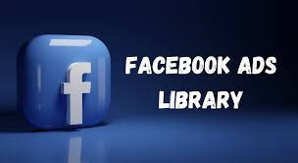
The Ad Library is a place where you can search for ads that are running across meta products.
We can use it to get information about the ads we see.
COMPETITIVE ANALYSIS
PURPOSE
By allowing users to see which ads are running.
Who is running them and the platforms they are displayed on .
Ad library to analyze competitor
strategies and identify trends.

Slide 48
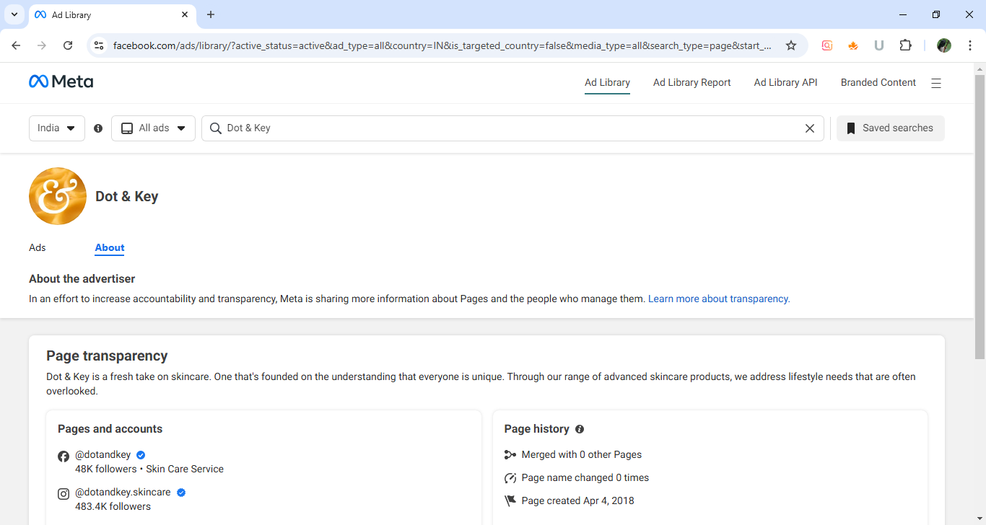
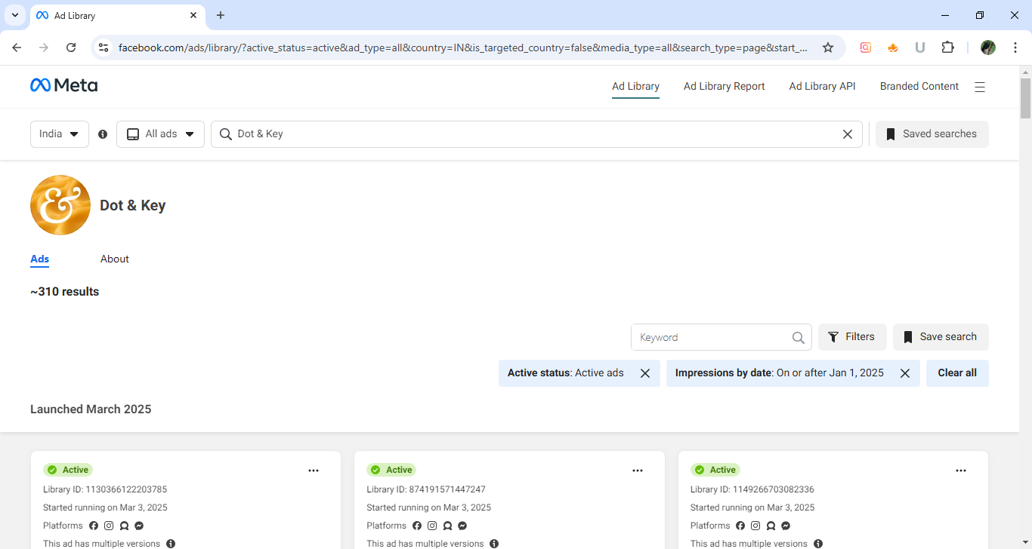
Dot&KEY has multiple versions of ad
like text, image, video etc
The platforms where the Dot&Key run an Ad through Facebook, Instagram, Audience network and Messenger.
Compared to Dot&Key , the Foxtale has
more number of active ads on their page.
Compared to Dot&Key, the Foxtale run their ad primarily through Instagram, Facebook and Messenger but they have less focusing on Audience Networking platform ad.

Slide 49
Launching strategy for the product “OIL FREE MOISTURIZER” from FOXTALE – A Skincare E-Commerce Brand through FACEBOOK AND INSTAGRAM.
1. Pre-Launch Phase (Build Anticipation)
Goal: Generate buzz and excitement before the product goes live.
TEASER CAMPAIGN
Content Type: Instagram Reels, Stories, and Facebook Posts.
Idea: Create short, mysterious videos or carousel posts with captions like: "Something BIG is coming your way! Get ready to glow like never before. Stay tuned for the reveal! #GlowUp #SkincareLaunch #ComingSoon"

Slide 50
COUNTDOWN POSTS
Content Type: Instagram Stories (Countdown Sticker) and
Facebook Posts.
Idea: Use a countdown timer to build anticipation. "The wait is almost over! Launching in 5 days! Set a reminder so you don’t miss it. #Countdown #SkincareLaunch #GlowAwaits"
BEHIND-THE-SCENES (BTS) CONTENT
Content Type: Instagram Reels, Stories, Facebook Videos.
Idea: Show the making of the product, packaging process or
team brainstorming. "Here’s a sneak peek of what we’ve been working on! Can you guess what it is? #BTS #SkincareJourney #GlowGoals"

Slide 51
2. Launch Phase (Drive Sales)
Goal: Officially launch the product and drive immediate sales.
Product Reveal Video
Content Type: Instagram Reels, Facebook Video Ads.
Idea: Create a 30-60 second video showcasing the product, its benefits, and how to use it. "IT’S HERE! Meet OIL FREE MOISTURIZER, your new secret to glowing skin! ✨ Glow Boosting! ✨ Blemish Prevention! ✨ Barrier Strengthening! Tap the link in bio to shop now! #NewLaunch #GlowUp #SkincareEssentials"

Slide 52
Instagram Shopping
Action: Enable Instagram Shopping and Facebook Shops to make the product easily purchasable.
Idea: Tag the product in posts and stories with a clear CTA. "Your glow is just a tap away! Shop OIL FREE MOISTURIZER now using the link in bio or tap the product tag. #ShopNow #GlowGoals #SkincareEssentials"
Facebook Ads Campaign
Ad Types: Carousel Ads, Video Ads, Collection Ads.
Targeting: Focus on demographics interested in skincare, beauty, and wellness.
Limited-Time Offer
Content Type: Instagram Stories, Facebook Posts.
Idea: Announce a flash sale or discount for the first 100 customers. "Flash Sale Alert! Get 10% OFF – OIL FREE MOISTURIZER for the next 24 hours only! Don’t wait—shop now before it’s gone! #FlashSale #GlowDeals #SkincareEssentials

Slide 53
3. Post-Launch Phase (Engage & Retain)
Goal: Build trust, encourage repeat purchases, and retain customers.
User-Generated Content (UGC) Campaign
Action: Encourage customers to share their results using a branded hashtag (e.g., #GlowWith Foxtale).
Idea: Repost UGC on your brand’s social media. "We’re OBSESSED with your glow! Keep tagging us with #GlowWith Foxtale for a chance to be featured. #CustomerLove #GlowUp #SkincareCommunity#foxtaleskins

Slide 54
Limited-Time Offer
Content Type: Instagram Stories, Facebook Posts.
Idea: Announce a flash sale or discount for the first 100 customers. "Flash Sale Alert! Get 10% OFF – OIL FREE MOISTURIZER for the next 24 hours only! Don’t wait—shop now before it’s gone! #FlashSale #GlowDeals #SkincareEssentials
Tutorial/How-To Videos
Content Type: Instagram Reels, Facebook Videos.
Idea: Show how to use the product in a skincare routine. "Here’s how to use [Product Name] for maximum results! Follow these simple steps to glow like a pro. Tap the link in bio to shop now! #SkincareRoutine #GlowTips #HowToUse"
Customer Testimonials
Content Type: Instagram Carousel Posts, Facebook Video Ads.
Idea: Share video testimonials from real customers. "Don’t just take our word for it—here’s what our customers are saying! Ready to try it for yourself? Tap the link in bio! #CustomerLove #GlowReviews #SkincareGoals"

Slide 55
SOCIAL MEDIA MARKETING FUNNEL
Facebook and Instagram Ads,
Influencers
videos
Case studies, product review or customer testimonials
Re-targeting, offers discounts
Sales
Advocacy

Slide 56
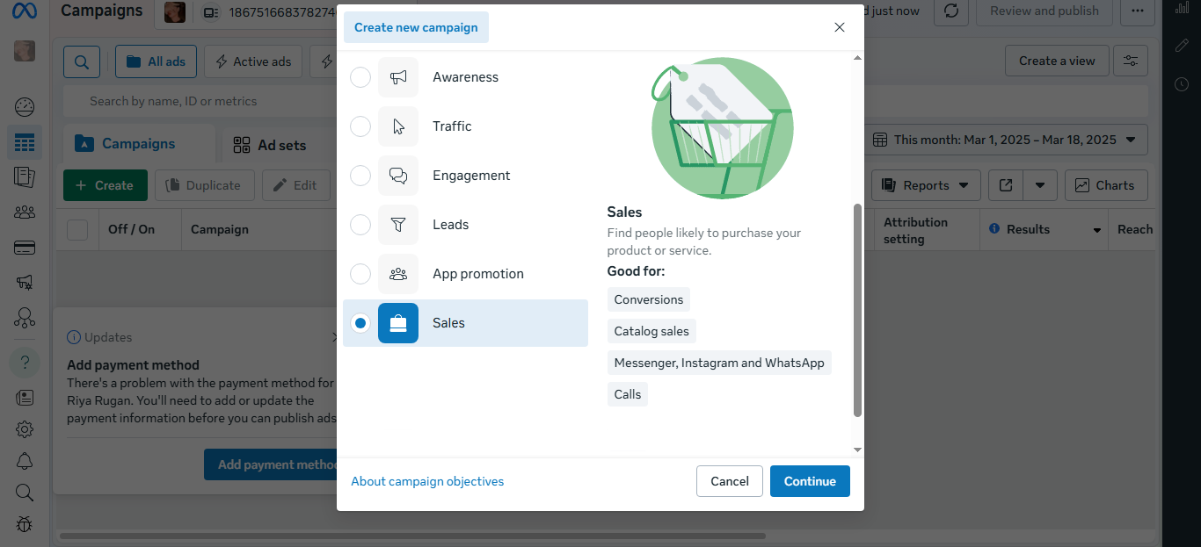
DEVELOPING SOCIAL MEDIA ADS CAMPAIGN STRATEGIS
GOAL : Convert potential customers into actual customers
BOFU: Bottom of funnel metrics
1.Purchase conversions
2.Customer acquisition cost
4Conversion-to-lead ratio
3.Return on ad spend(ROAS)
ADS MANAGER
CREATING A NEW AD CAMPAIGN
Here am choosing sales for conversions,
catalog sales, messenger and instagram, whatsapp calls.
BRAND NAME: FOXTALE
PRODUCT NAME : OIL FREE MOISTURIZER

Slide 57
TARGET AUDIENCE
DEMOGRAPHICS:
Age: 18–35 years.
Gender: Women
Location: Urban and semi-urban areas in India.
PSYCHOGRAPHICS:
Health-conscious individuals seeking science-backed skincare.
Millennials and Gen Z who value minimalist and effective products.
Consumers with sensitive skin or specific skincare concerns (e.g., acne, dryness).

Slide 58
PREFERENCES:
Consumers are increasingly seeking clean beauty, science-backed, and sustainable skincare products.
Demand for personalized skincare solutions is rising.
PAIN POINTS:
Overwhelmed by too many product options.
Concerns about ingredient safety and effectiveness.
FOXTALE’S APPEAL : ADDRESSES THESE PAIN POINTS WITH MINIMALIST FORMULATIONS AND TRANSPARENT COMMUNICATION.

Slide 59
CHOOSING THE RIGHT PLATFORM
Selecting the social media platforms that best align with our audience and campaign goals.
Here am choosing Instagram and Facebook.
Because Instagram has Ideal for Visually-driven content and Facebook is great for a wide range of demographics.

Slide 60
CREATE A CONTENT CALENDER
Planning our ad content in advance
SCHEDULING:
Determine when to launch your ads for maximum impact.
CONSISTENCY:
Maintain a consistent posting schedule to keep your audience engaged.

Slide 61
SOCIAL MEDIA WEEKLY PLANNING CONTENT CALENDER
APRIL-2025 | PLATFORM | CONTENT TYPE | DETAILS
WEEK-1 Create buzz and tease the new product | Instagram +Facebook stories | Announce the upcoming product launch | Post a teaser video with a caption like, "Something exciting is coming soon! Stay tuned."
WEEK-2 Officially launch the product and drive traffic | Instagram +Facebook Carousel post and YouTube + Instagram Live | Expert Talk (Dermatologist) and Benefits of the product | Dermatologist explains the science behind hyaluronic acid. Post about the product’s benefits and how to use it
WEEK-3 Push for sales and re-engage interested users. | Facebook+Instagram-Reel and single post. | "How to Use" guide or tutorial video for the product. Share customer reviews or testimonials to build trust. | Post before-and-after visuals or videos showcasing the product’s results.
WEEK-4 Build loyalty and encourage repeat purchases. | Instagram+Facebook- Carousel post and Reel | Engagement (Poll) Poll – “What’s your result after using our product either your skin looks good/bad? | Offer a discount to repeat customers for the product.

Slide 62
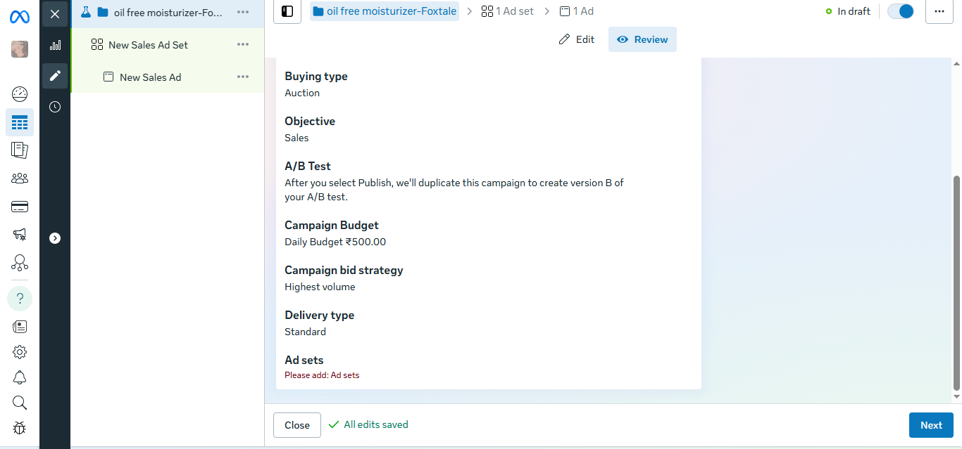
SET YOUR BUDGET
CAMPAIGN GOALS
CONVERSION: Focus on sales, lead generation, or product purchases
BUDGET ALLOCATION:. Conversion: 40-50% of total budget.
EXAMPLE BUDGET BREAKDOWN FOR FOXTALE:
TOTAL MONTHLY BUDGET: ₹40000
Awareness campaign: 30% from total amount.
Consideration campaign: 35% from total amount.
Conversion campaign: 35% from total amount.
DAILY BUDGET: Start with ₹500 /day and scale up to ₹ 1000 based on performance.

Slide 63
EVALUATE AND REPORT
After the campaign conducts, evaluate its success:
1.PERFORMANCE VIEW: Analyze what worked and what didn’t
2.ROI CALCULATION: Measure return on investment to assess financial success
3.LESSONS LEARNED: Identify insights to improve future campaign
ROAS (Return on Ad Spend)
Definition: ROAS measures the revenue generated for every dollar spent on advertising.
Formula: ROAS = (Revenue from Ads) / (Ad Spend)
Approximate ROAS for Skincare Products:
Good ROAS: 3:1 to 4:1.
Excellent ROAS: 5:1 or higher (Indicates highly effective campaigns).
Break-even ROAS: 2:1.

Slide 64
INDUSTRY BENCHMARKS FOR SKINCARE PRODUCTS
Average ROAS: 3:1 to 4:1.
Average ROI: 20%-30%.
Top-Performing Campaigns: ROAS of 5:1 or higher, ROI of 40% or more.
ROI (Return on Investment)
Definition: ROI measures the overall profitability of your marketing efforts, considering all costs.
(Example: Product cost, shipping, ad spend).
Formula: ROI = [(Revenue - Total Costs) / Total Costs] x 100
Approximate ROI for Skincare Products:
Good ROI: 20%-30% (Indicates healthy profitability).
Excellent ROI: 40% or higher (Indicates highly profitable campaigns).
Break-even ROI: 0% (Revenue equals total costs).

Slide 65
By aiming for a ROAS of 3:1 or higher and an ROI of 20%-30% or more, Foxtale can ensure profitable and sustainable growth for its skincare products.
CALCULATION FOR OIL FREE MOISTURIZER - MONTH
Ad Spend: ₹ 10,000
Revenue Generated: ₹ 40,000
Product Costs (including shipping): ₹ 15,000
Profit: 40,000 (revenue cost) - 10,000(ad spend cost)- 15,000(product cost) =15,000
ROAS = (Revenue from Ads) / (Ad Spend)
ROAS: 40,000 / 10,000 = 4:1.
ROI = [(Revenue - Total Costs) / Total Costs] x 100
ROI: [(40,000 −25,000) / 25,000] x 100 = 60%.

Slide 66
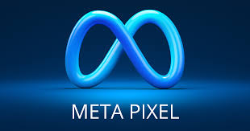
META PIXEL
The Meta Pixel allows you to: 1.Track website activity
2.Measure ad effectiveness
3.Build custom audiences
4.Retarget ads
Importance Of META pixel: 1.Improving advertising ROI
2.Better targeting
3.Enhanced website analytics

Slide 67
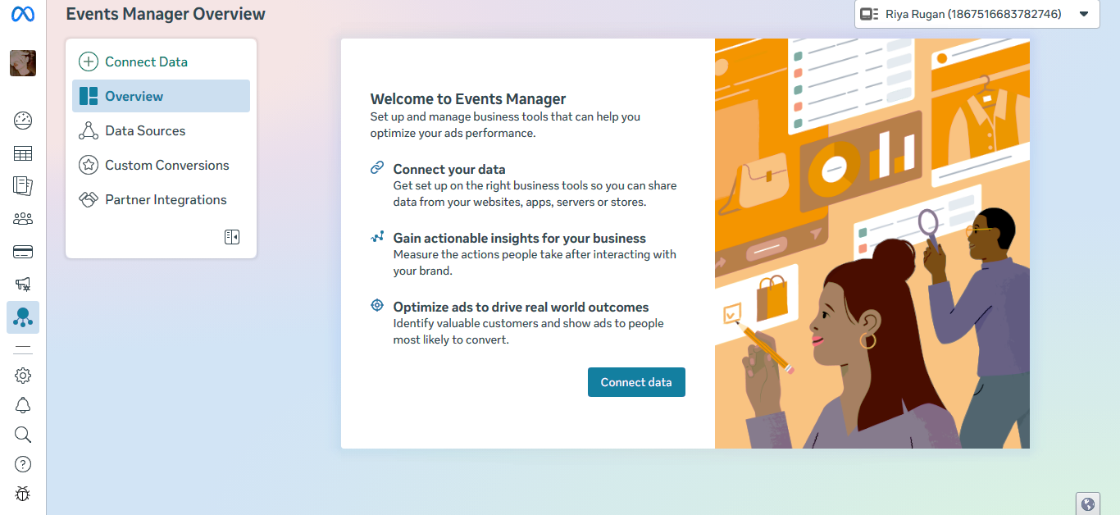
TRACKING AND REPORT
Pixel is a tracking code to track activities on the website.
1.Here we set up the conversion tracking and activity tracking on your website by using Meta pixel tag.
2.By installing base code, here if we have a website access then paste the base code to website.
3.For sales campaign , here we create a custom conversion by setting up a new pixel.

Slide 68
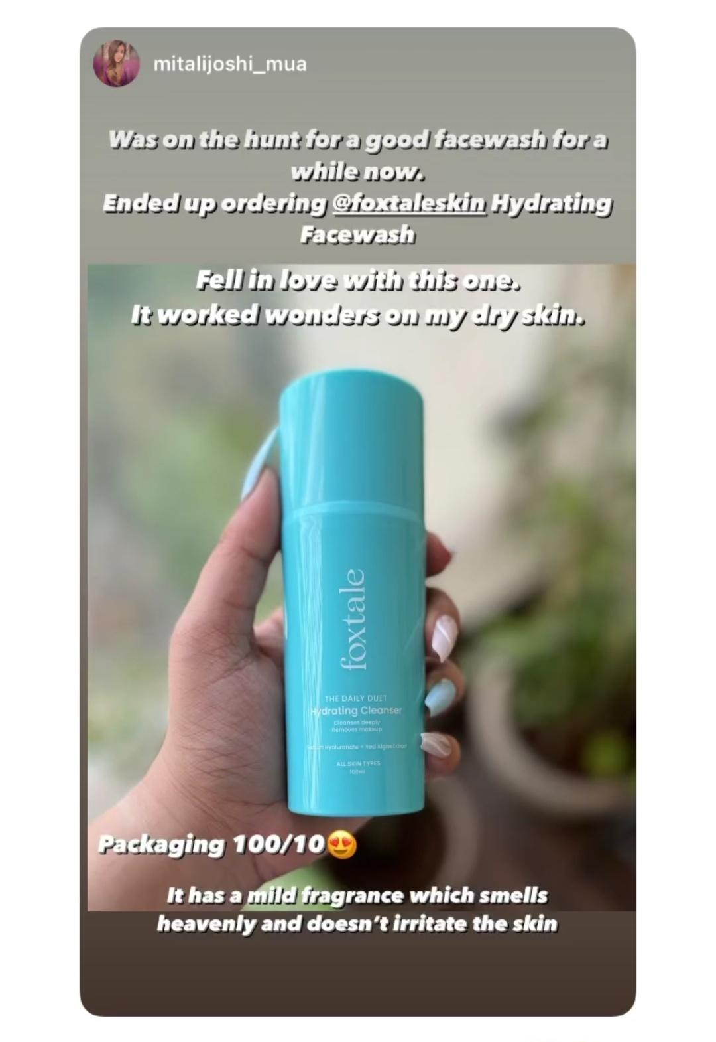
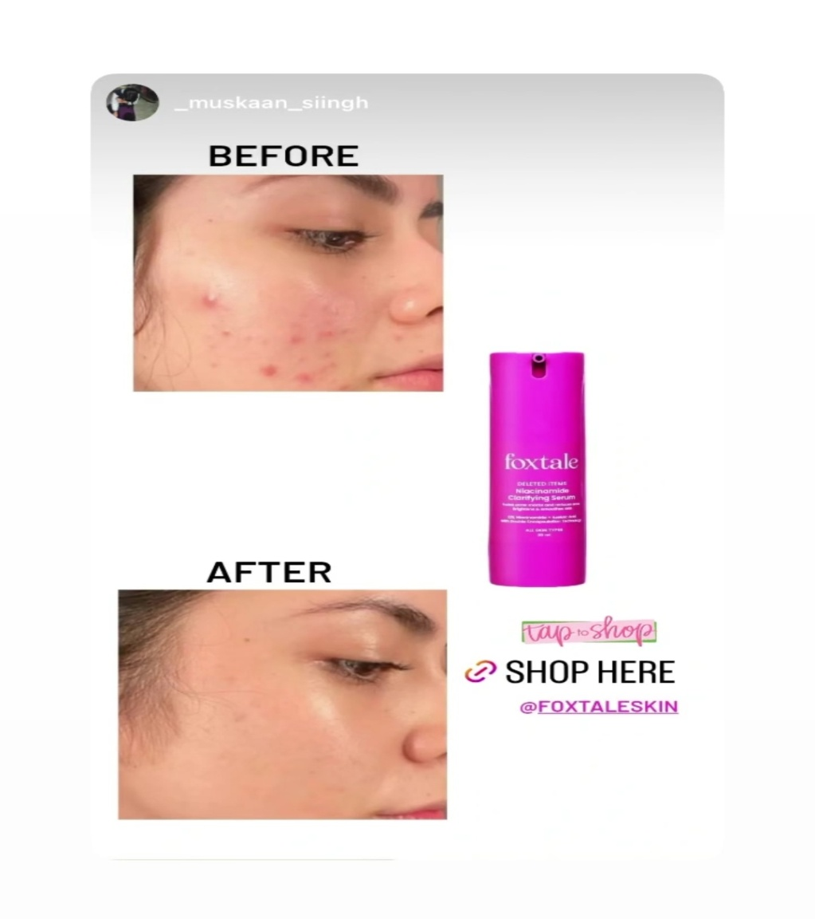
THESE ARE SOME CUSTOMER TESTIMONALS IMAGES OF FOXTALE

Slide 69
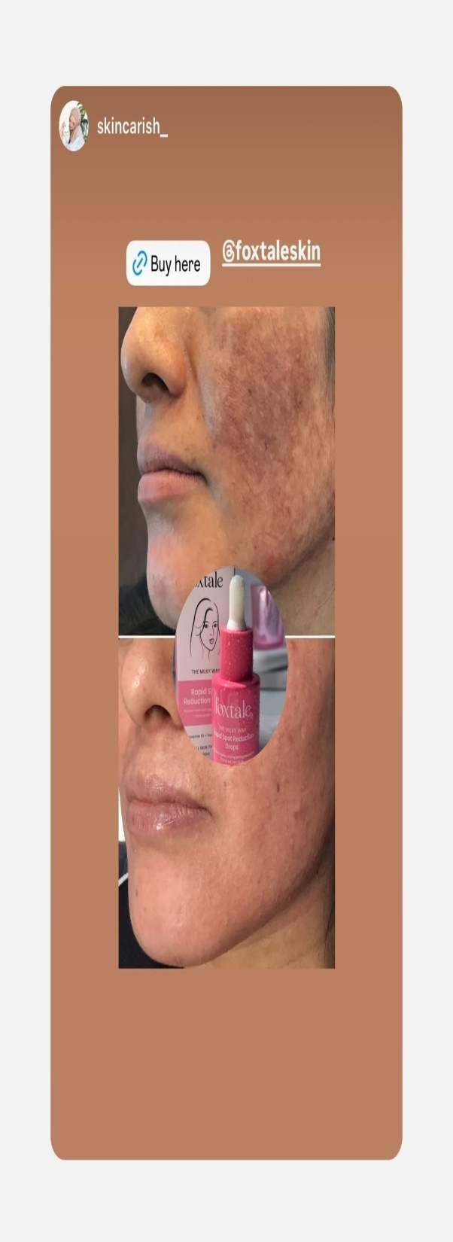
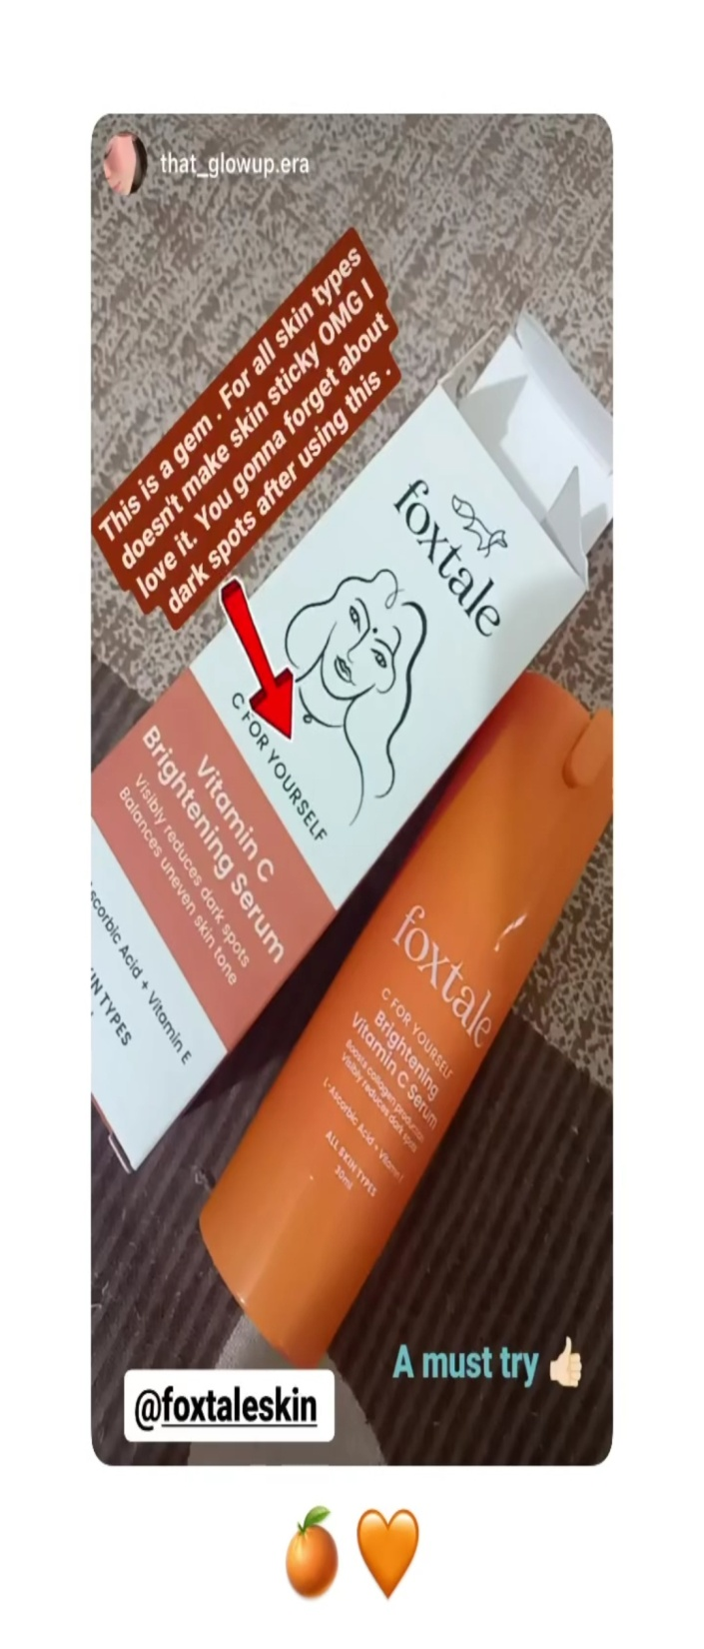
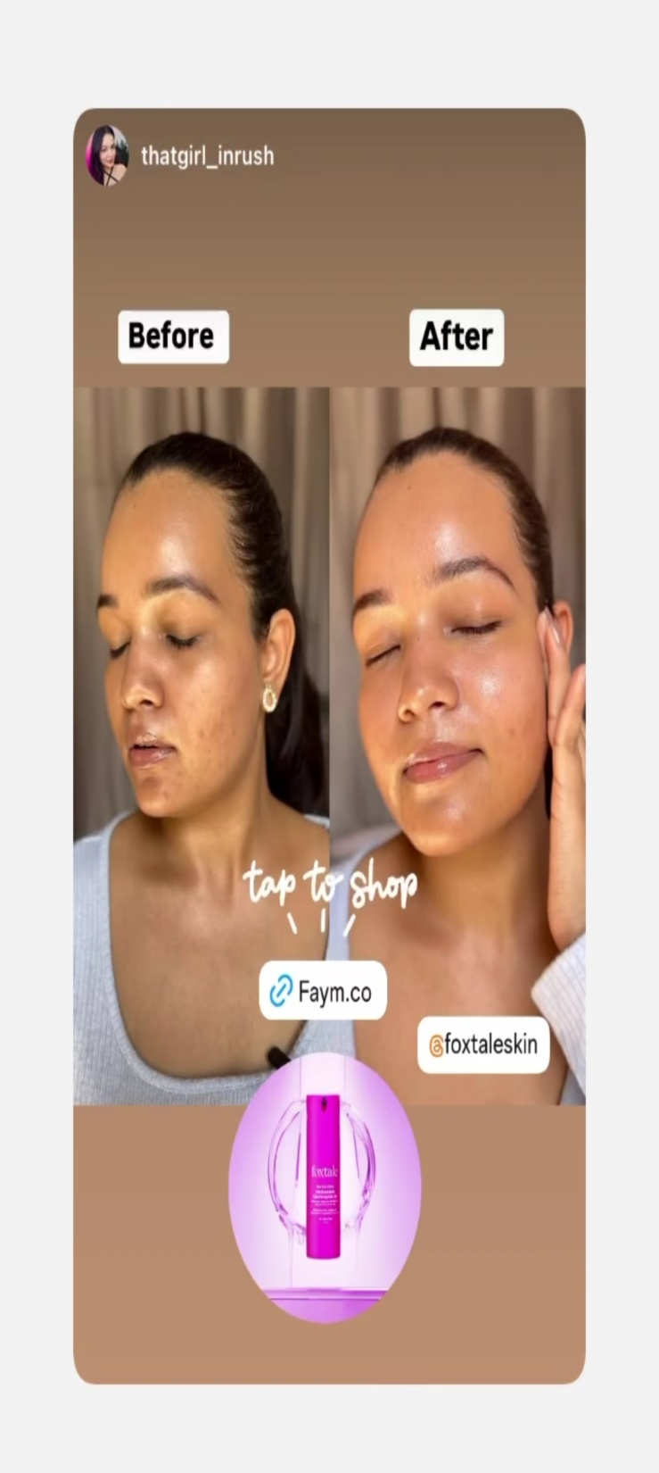

Slide 70
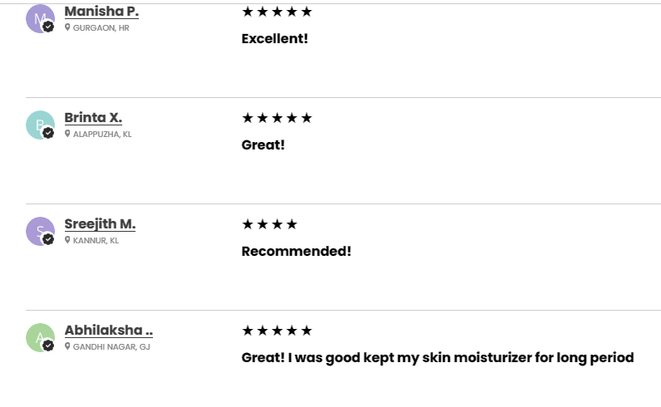
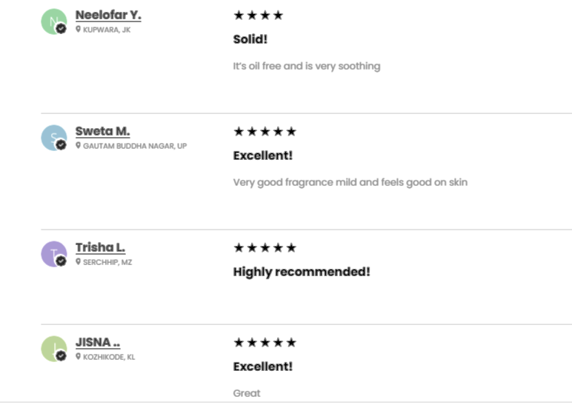
CUSTOMER FEEDBACK
These are some feedback images of the customer for the product –
“OIL FREE MOISTURIZER”

Slide 71

- M.PRIYA

